Slide 1



Full Stack Development
Topic
Planning Your Data Model
Name : Sai Ganesh Roll No : 22H51A05F4 Branch : CSE

Slide 2



Introduction to Data Modeling
Data modeling is the process of creating a visual representation of a system's data.
It helps in understanding the data requirements and their relationships.
A well-planned data model serves as a blueprint for database design and implementation..

Slide 3


Importance of Data Modeling
Effective data modelling enhances data quality and consistency across the organization.
It facilitates better decision-making by providing clear insights into data relationships.
A good data model can save time and resources during the development lifecycle.

Slide 4

Types of Data Models
Conceptual Data Models: Describe the high-level structure and relationships of data. They focus on what data is needed and how it relates without worrying about implementation.
Logical Data Models: Provide detailed specifications of the data structure. They outline tables, columns, and relationships, independent of how the data will be physically stored.
Physical Data Models: Translate the logical model into a specific database schema. They detail how the data will be stored, indexed, and optimized in a particular DBMS.

Slide 5
Key Components of Data Models
Entities represent objects or concepts that hold data relevant to the system.
Attributes describe the properties or characteristics of the entities.
Relationships define how entities are associated with one another.

Slide 6


Steps in Data Modeling
Start with requirements gathering to understand user needs and system functionalities.
Create a conceptual model to establish the main entities and their relationships.
Refine the model into logical and then physical formats for implementation.

Slide 7
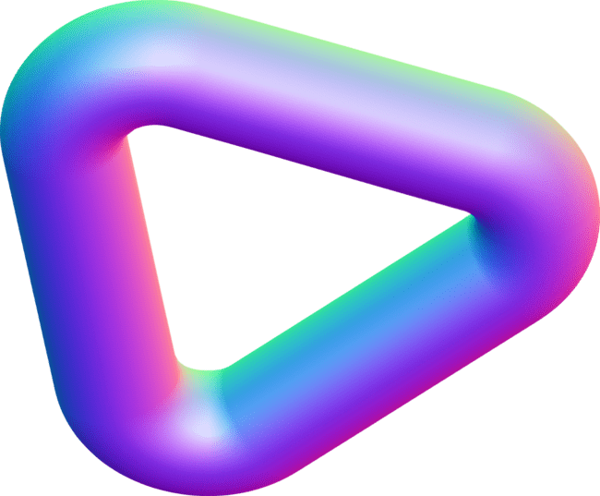
Common Data Modeling Tools
PowerDesigner: Provides data modeling and metadata management with strong support for conceptual, logical, and physical data models.
MySQL Workbench: A tool specifically for MySQL databases, offering capabilities for designing and modeling data structures.
ERDPlus: A free web-based tool for creating ER diagrams, relational schemas, and other data models.
ER/Studio: A powerful tool for designing, documenting, and managing data models.

Slide 8

Challenges in Data Modeling
Incomplete or unclear requirements can lead to ineffective data models.
Rapidly changing business needs may require frequent updates to the data model.
Ensuring data integrity and consistency can be complex in large systems.

Slide 9


Conclusion
A well-executed data modeling process leads to better data management and utilization . Continuous learning and adaptation are essential for successful data modeling practices.

Slide 10



